Slide 1
New ValleyMLS.com Member Agent Websites Coming Soon!

Slide 2
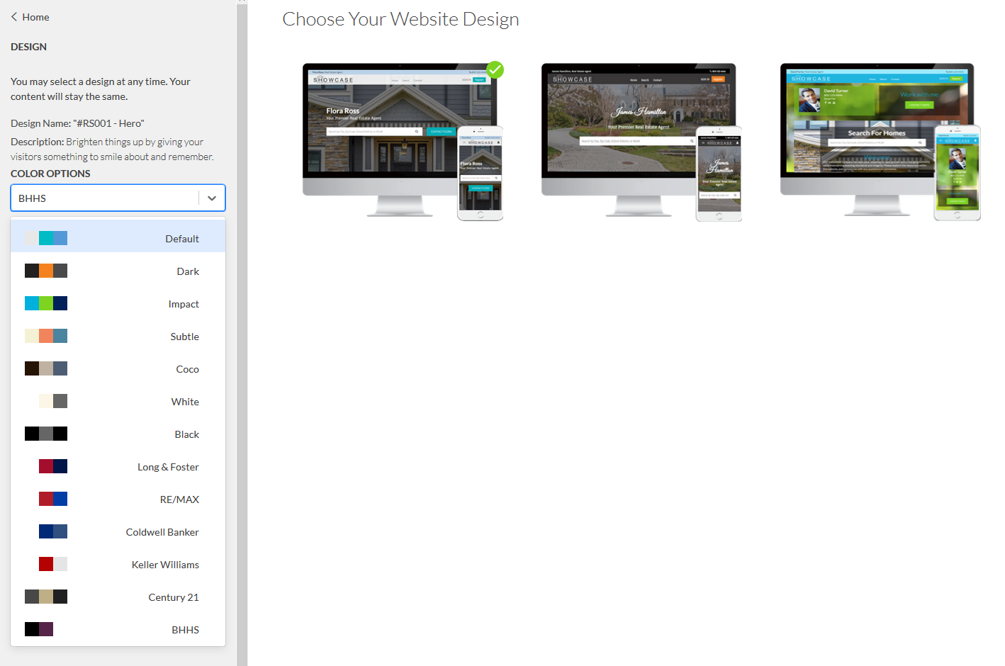
3 Designs to Choose From – Color Scheme Options

Slide 3
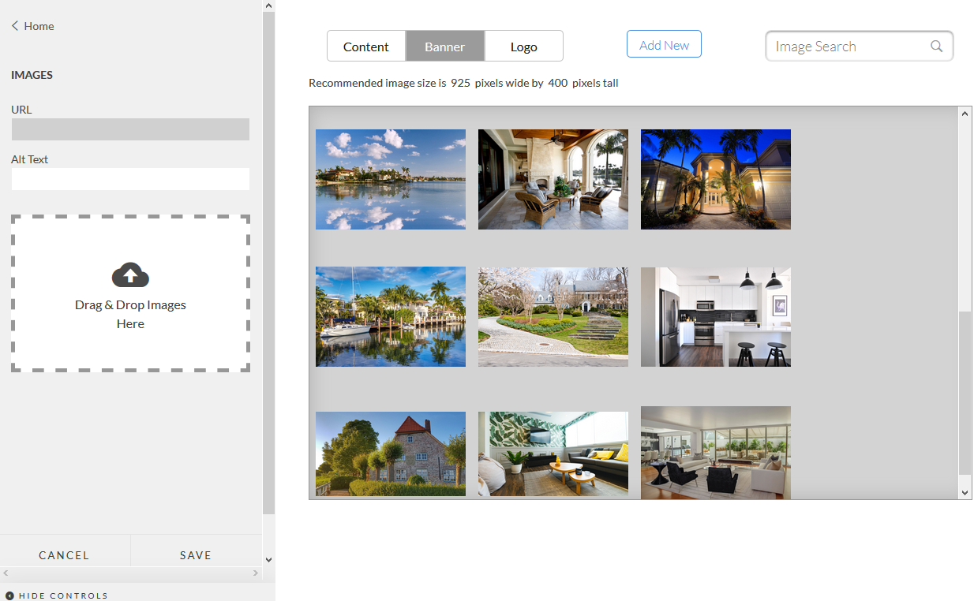
Choose Your Banner Graphics or Upload Your Own Image

Slide 4
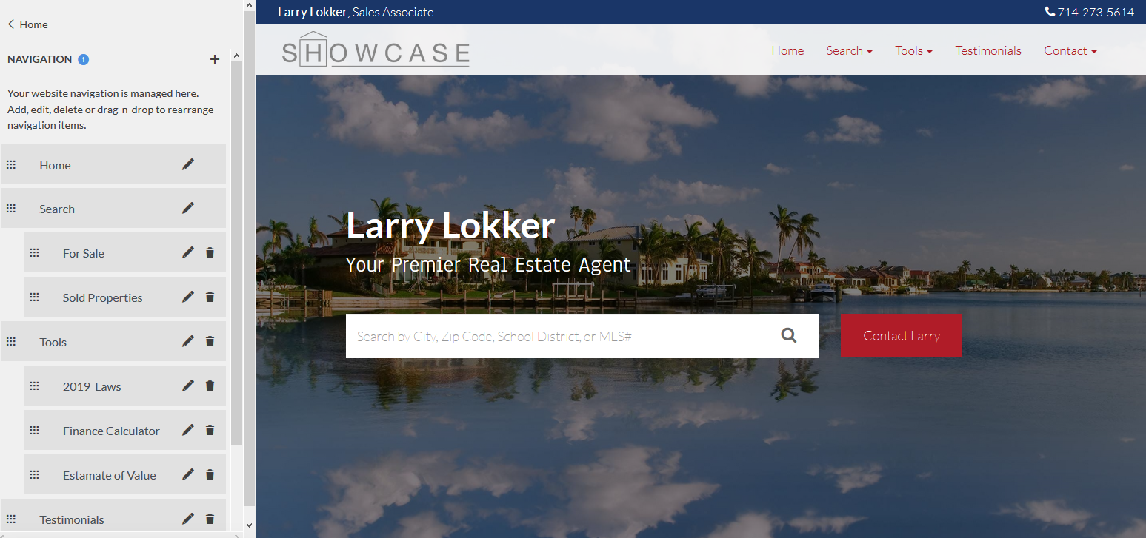
Easy to Set Your Navigation Tabs and Links

Slide 5
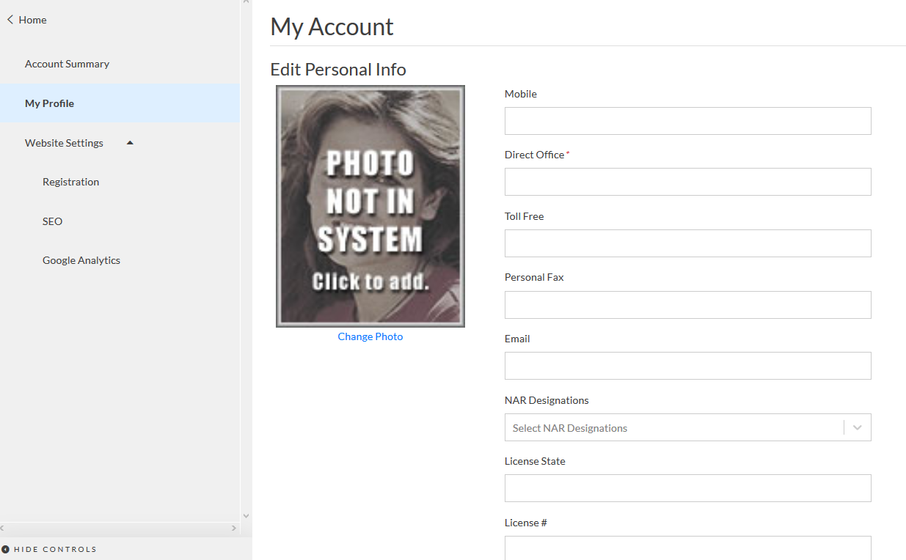
Easy Set Up or Change Your Profile

Slide 6
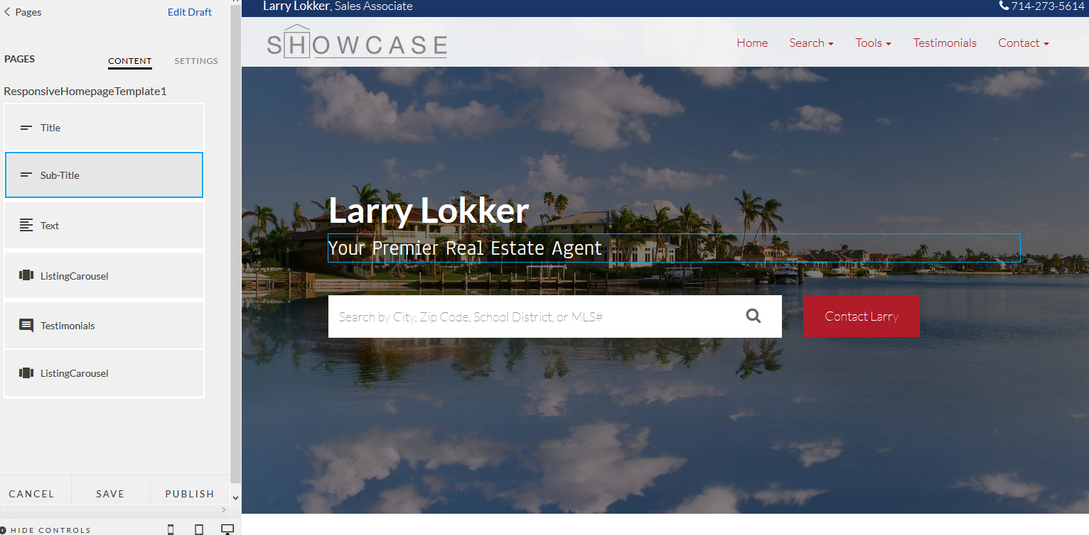
Fill In The Fields To Modify Content

Slide 7
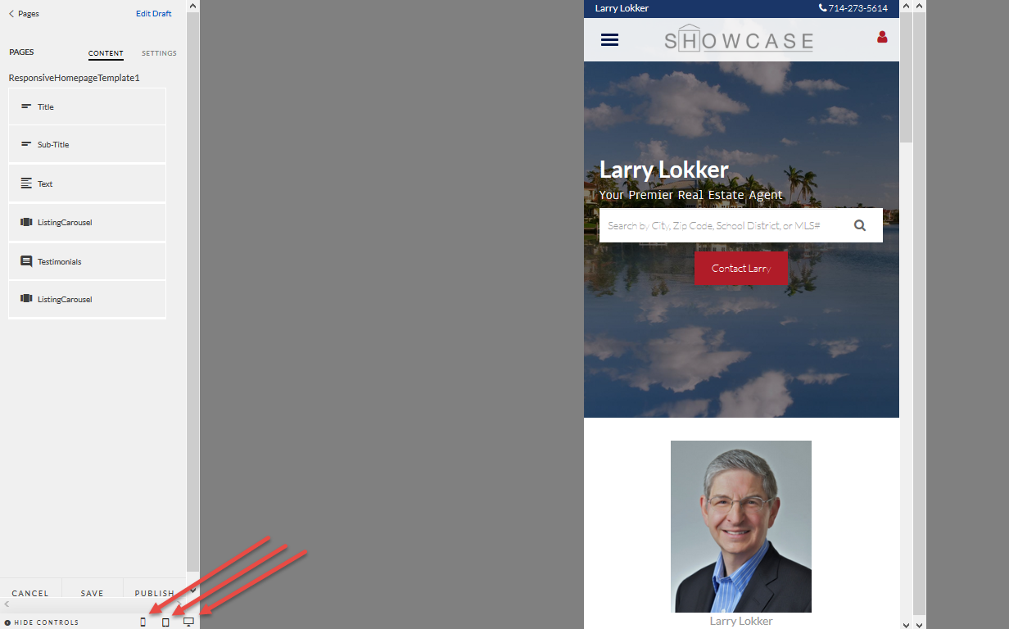
Preview Changes in: Phone, Tablet and Desktop View

Slide 8
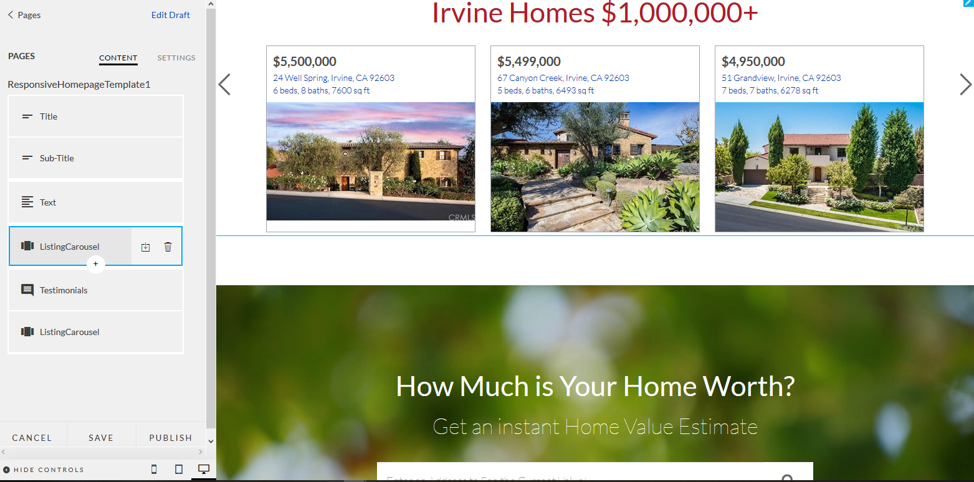
Easily Add Content Like: Custom Search Carousels or Testimonials

